Slide 1
Next Generation Nuclear Power – Part I
Nuclear is the other power technology for which major improvements are forecast
And, because nuclear has ~ no carbon footprint, it's going to be hard to ignore
So in what areas might strong improvements be possible? These:
Reactors using more naturally abundant fuels
Reactors using smaller quantities of fuel
Reactors producing shorter lived waste
Reactors that are smaller, simpler, and cheaper to build
And topping most everyone's list: REACTORS THAT ARE MUCH SAFER

Slide 2
In an earlier version of this lecture:
I tried to describe all of the major new nuclear reactor designs
Or at least all being planned, or widely discussed, here in the US
But I learned that there are well over a dozen new types of reactors alone
With (often) many dozens of designs being developed for each type
Reviews I found thus quickly degenerated into simple long lists of reactors
Each typically "explained" by no more than 1-2 figures, on 1-2 pages
Using figures & quotes copied directly from the reactor's developers (!)
Providing ~ no understanding of the design's real strengths or weaknesses
So, instead, I am going to focus strongly on designs offering revolutionary change
Particularly in the area of safety

Slide 3
I am going to divide the safety challenge into two parts:
I) SHORT TERM SAFETY = Preventing radioactive releases from reactors
Which goes right back to my earlier "But they blow up!" lecture
And the TMI, Chernobyl and Fukushima Dai Ichi accidents it described
We now want to make the repeat of such accidents virtually impossible!
II) LONG TERM SAFETY = Preventing radioactive releases from spent fuel
Which might be partially addressed by improved storage techniques
But, given the HUGE time scales involved (hundreds of thousands of years!!!),
an immensely more plausible "solution" is to switch to reactors
that produce waste with immensely shorter-lived radioactivity

Slide 4
Part I: Short Term Safety = Reactor Safety
My introductory lecture attributed the Chernobyl accident to the RBMK reactor's:
- Neutron moderation scheme making the reactor fundamentally unstable
- Use of graphite neutron moderator in a primarily gaseous ambient
Facilitating a massive graphite fire when damaged reactor was opened to air
- Lack of a western-style containment vessel
- 2nd string operators running experiments violating their own plant rules
The final two problems hugely expanded the scope of the disaster
Those problems were largely unique to this Soviet reactor design & operation
But gas-cooled graphite moderation is also planned in many Gen IV nuclear reactors
Including in pebble bed reactors promoted by the U.S. DOE and others

Slide 5
And then there is the Three Mile Island Accident:
Which was attributed to human errors:
Earlier minor and major maintenance errors
As well as inadequately trained and ill-informed reactor operators
Compounded by shortcomings in equipment design:
A control system providing hugely incomplete & incomprehensible information
Limited automation (which operators did not trust and frequently overrode)
A natural tendency to accumulate explosive H₂ + O₂ gas upon overheating
Exacerbated by fragmentation of U.S. reactor design and manufacturing:
Which undercut opportunities to develop & disseminate "best current practices"
And also discouraged development of high-quality shared training schools
Such as the U.S. Maritime Academies that serve our shipping industry

Slide 6
Bringing us to Fukushima
Which, 38 years later, fell victim to the SAME type of hydrogen explosion as TMI
REMEMBER: H₂ + O₂ combustion explosions, and NOT nuclear explosions,
were what produced both the TMI and Fukushima containment breaches!
Which was compounded by:
A remarkably stupid Japanese government/TEPCO utility collusion
That placed the reactors where Tsunami's were an absolute certainty
And then located generators & equipment essential for a safe shutdown
in the lowest, most Tsunami-prone beachfront locations
And finally, hid a study reevaluating the Tsunami threat and protective measures
Not so much because they contested Fukushima's reevaluated vulnerability
But for fear of public clamor for similar protection at less vulnerable sites

Slide 7
But is there a common thread to all three accidents?
Yes:
Today you cannot just turn off a reactor,
and then walk (or run) away!
INSTEAD: It must be VERY VERY carefully nursed back to a safe/stable "off" state
Requiring DAYS of time, water, pumps, power, and expert human control
So how MIGHT YOU design a reactor that would safely shut itself down?
To answer that, you have to know what safe shutdown really means
Which we can learn by studying present day reactors:

Slide 8
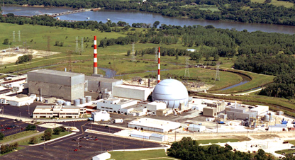
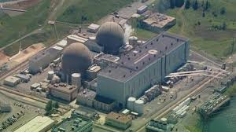
Present day reactor designs are categorized by "generations"
Gen I = Experimental or prototype reactors (built in 1950's and 1960's)
Gen II = Most current commercial reactors (1970's – present)
Including, from my earlier lecture: BWR (boiling water reactors) and
PWR (pressurized water reactors)
Nearby North Anna power plant:
Dresden Illinois reactors which
came online in 1970 and 1971
These two PWR reactors
came online in 1978 and 1980

Slide 9
To reactors being built today:
Which are called: Gen III / Gen III+ Reactors
These are under construction or proposed for the following US sites:
Type: Location: Utility Company: Startup Date:
AP1000 Vogtle, GA (2) Southern Nuclear Operating Scheduled 2017 & 2018
AP1000 V.C. Summer, SC (2) South Carolina Electric & Gas Scheduled 2018 & 2019
AP1000 William States Lee, SC (2) Duke Energy Proposed 2024 & 2026
AP1000 Turkey Point, FL (2) Florida Power & Light Proposed 2022 & 2023
AP1000 Sharon Harris, SC (2) Duke Energy Proposed 2026
AP1000 Green River, UT (2) Blue Castle Transition Power ?
ES-BWR North Anna, VA Dominion Proposed 2022
ES-BWR Grand Gulf, MS Entergy ?
ES-BWR Fermi, MI Detroit Edison ?
ES-BWR River Bend. LA Entergy ?
Plus other proposed sites that are apparently now in business or regulatory limbo

Slide 10
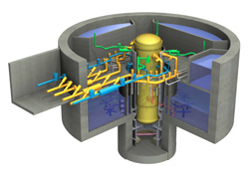
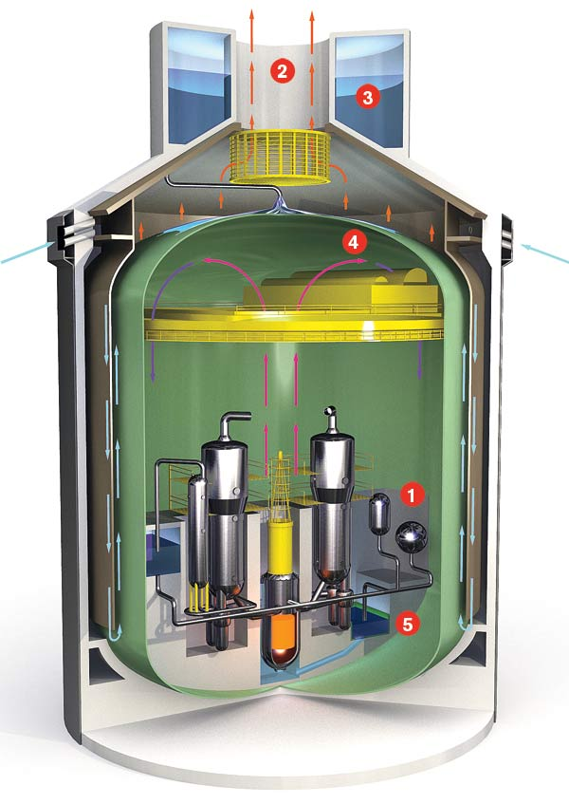
Looking more closely at the two big U.S. Gen III/III+ designs:
Which come from GE/Hitachi and Westinghouse, respectively
And which focus on automatic/passive shutdown, and on cost reduction
ES-BWR (economic simplified BWR)
AP1000 (advanced passive PWR)
Significant changes are apparent in even these figures
www.technologyreview.com/article/411028/new-nukes/
An Introduction to Sustainable Energy Systems: www.virlab.virginia.edu/Energy_class/Energy_class.htm

Slide 11
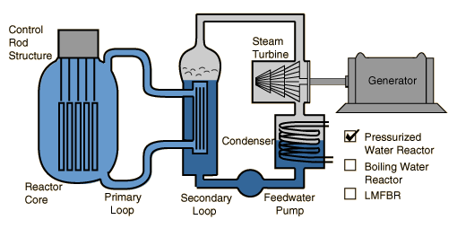
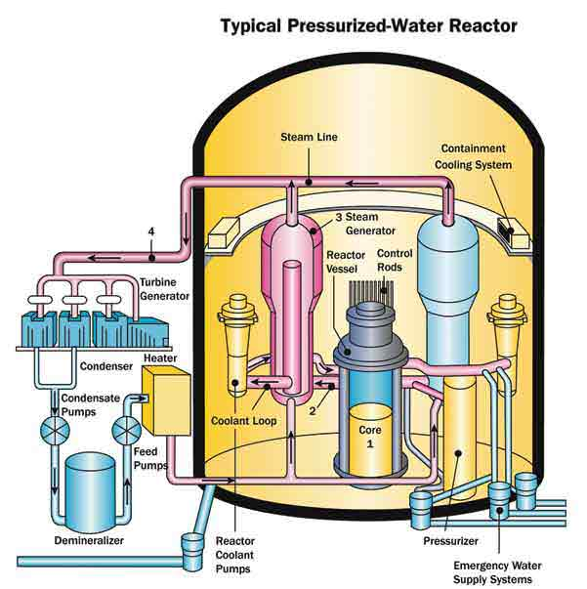
Both are efforts at improving our current reactor designs
Based primarily on SIMPLIFICATION
Which is used to address both safety and cost
Simplification is most heavily promoted in the AP1000 PWR design
To illustrate, let's review present day (Gen II) Pressurized Water Reactors:
Gen II PWR's are are this: Or, a bit more completely, this:
http://hyperphysics.phy-astr.gsu.edu/hbase/nucene/reactor.html

Slide 12
But those drawings do not tell anywhere near the whole story
Which I discovered by researching how a Gen II PWR is shut down
That research led me to two particularly interesting sources
The blog of a nuclear engineer / PWR plant operator:
"A primer on a how a pressurized water reactor shuts down" ¹
A U.S. Nuclear Regulatory Commission Technical Training Center manual:
"Pressurized Water Reactor (PWR) Systems" ²
These gave me a much more complete picture
of the very complex hardware and many operating modes
of a PWR's complete cooling (and emergency cooling) system
Which I can partially convey via the figures from the NRC training manual:

Slide 13
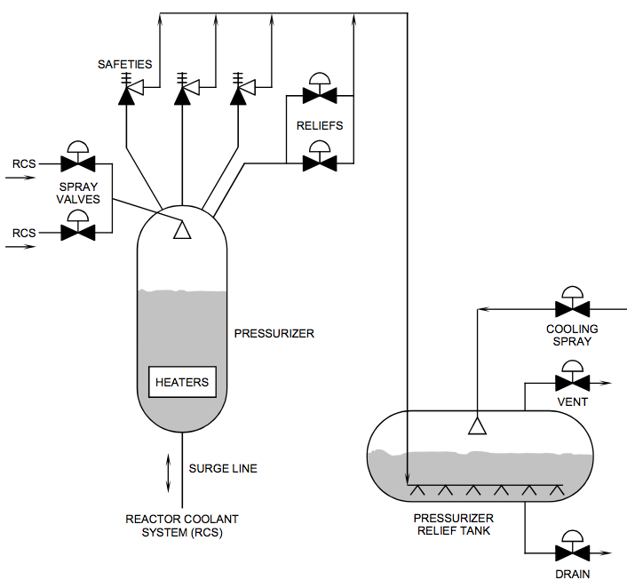
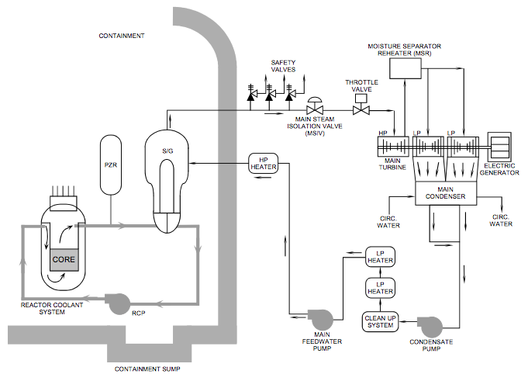
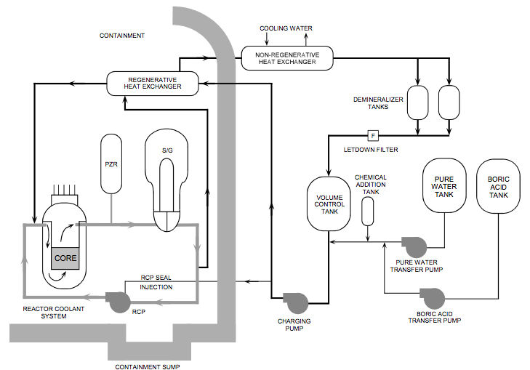
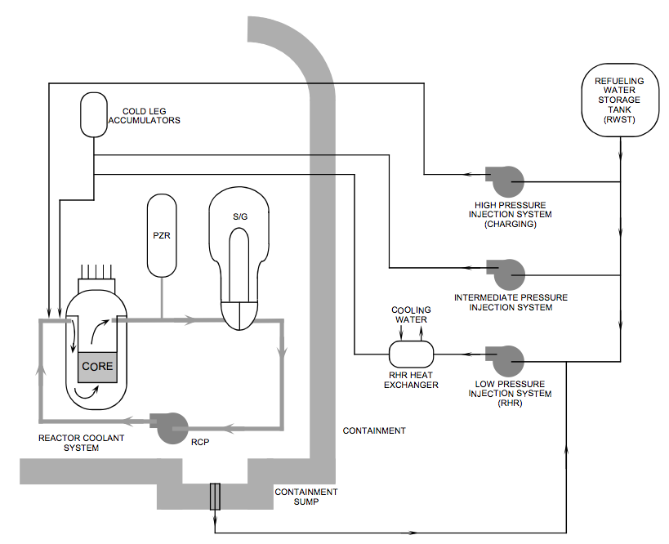
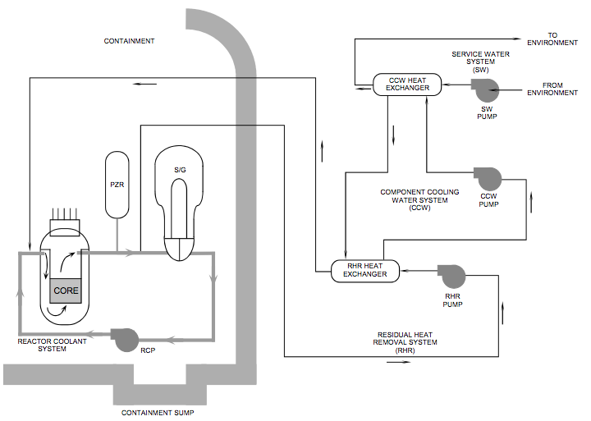
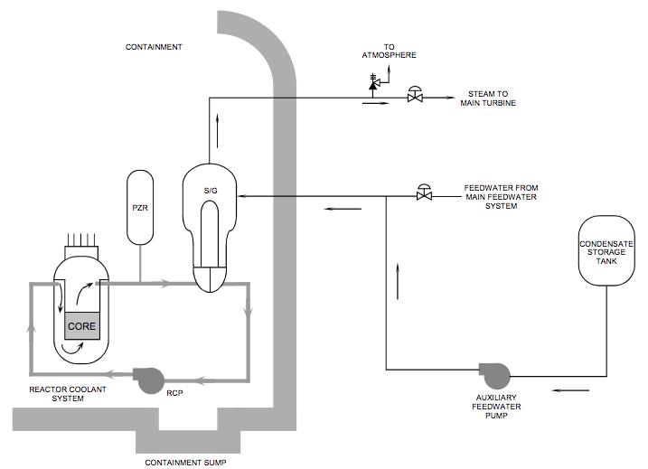
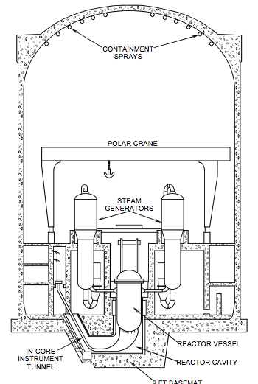
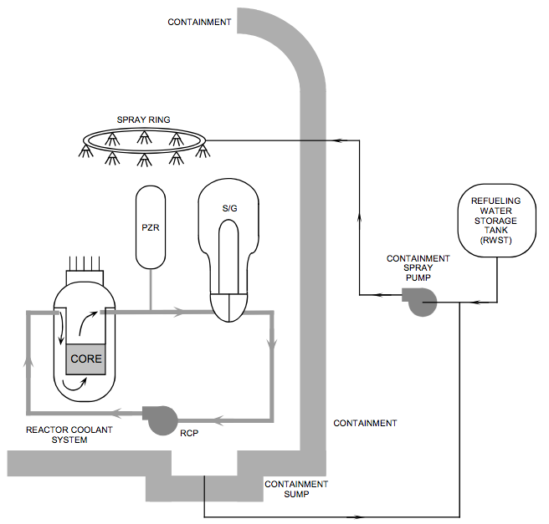
From NRC's explanation of one present day PWR cooling system:

Slide 14
That cool down explanation required so many figures because:
The cooling system can be called upon to operate in so MANY different ways:
Normal operation
Initial shutdown (when high temp convection does not require pumps)
Hours later when lower temperatures make pumps essential
Different ways of supplying water to those pumps
Different ways of dumping heat absorbed in that water
Plus alterations in operating modes based on emergency priorities, for instance:
If the most immediate risk appears to be running out of water
Or if the immediate risk is of loosing power to the emergency pumps
(and so on and so on)

Slide 15
The manual and blog were interesting reads
I learned a lot, and saw lot of cleverness employed to deal with various situations
HOWEVER:
I was appalled by the complexity, which amounted to a "Plumber's Nightmare"
I was also alarmed by how many pipes penetrated the containment walls
Offering so many paths for the possible escape of radioactivity
Many, many more than shown in the common PWR diagrams!
And by how easy it might be for an error/malfunction to facilitate that escape,
Via the wrong combination of valves opened at the wrong time
Or by malfunctions of those many pipes, valves, and other components

Slide 16
In engineering, new designs can have a common failing:
The initial design starts out addressing known challenges
Then, discovering a new challenge, a layer is added to deal with it
Then, finding another challenge, another layer is added to deal with it . . .
(with the danger of these engineering layers degenerating into band-aids)
Best Engineering Practice & Quality by Design require that someone eventually yell:
"STOP! It's time to start over and (using what we NOW know)
design a simpler system meeting ALL of these challenges"
Or, as put more eloquently by French Author/Aviator Antoine de Saint-Exupery:
"A designer knows he has achieved perfection not when there is nothing left to add,
but when there is nothing left to take away"

Slide 17
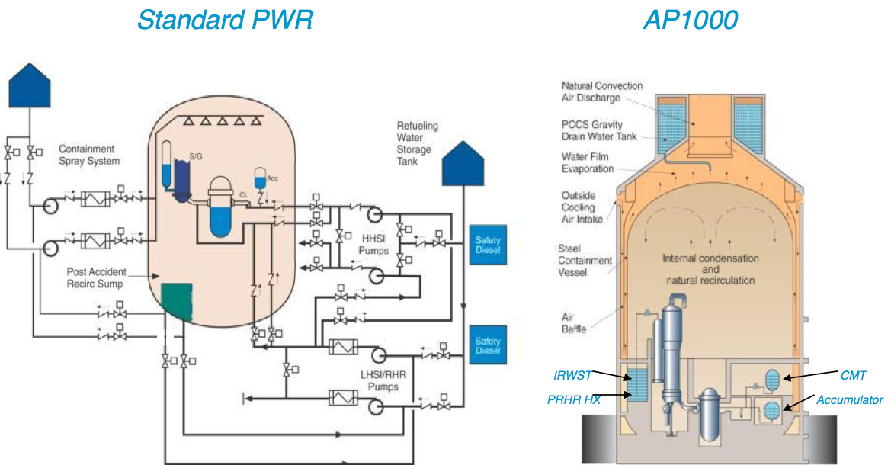
Which drove Westinghouse to simplify their Gen III/III+ AP1000:
vs.
~ Built-in heat-exchanger +
evaporative-cooling tower
Assuming drawings are similarly inclusive, simplification IS dramatic
Further, heat-exchanger + evaporative-cooling scheme seems really clever

Slide 18
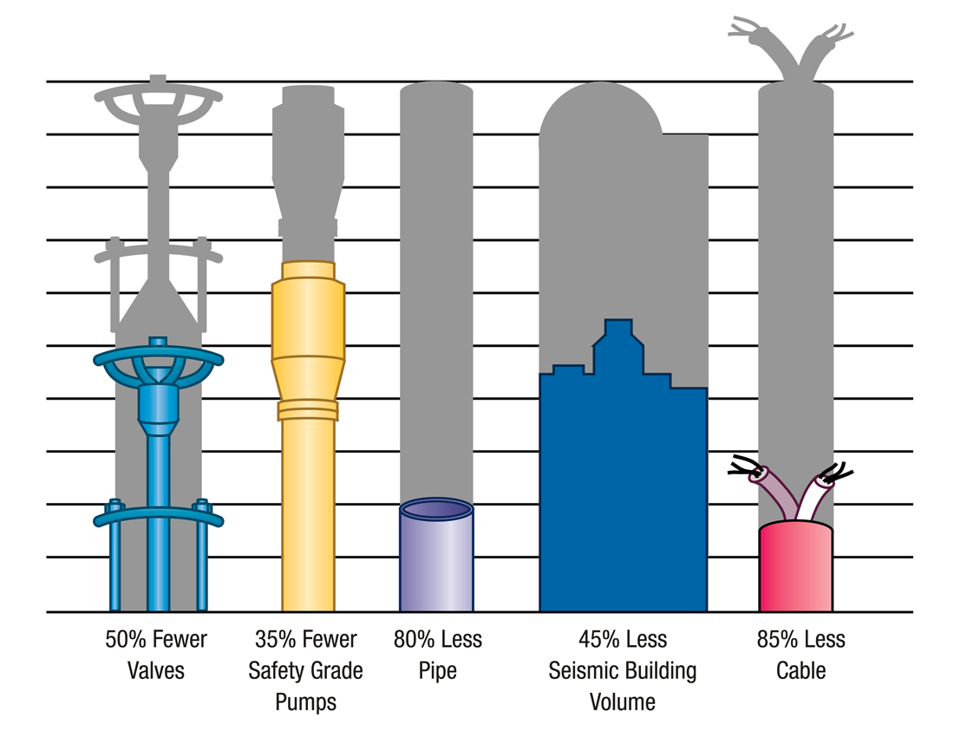
But an even more dramatic figure is:
AP1000 Advanced PWR vs. present day PWR reactor parts/component count:
It's additionally claimed that simplification & shrinkage allow the AP1000:
To be made from 300 factory-assembled and pre-tested modules
Facilitating a short (for reactors) 36 month construction schedule

Slide 19
Comparable information for the GE/Hitachi ES-BWR design?
Detailed information was much harder to come by
Perhaps because development/deployment is ~ 5-10 years behind AP1000
But the claimed simplification was not quite as dramatic as in AP1000:
"25% pumps, valves and motors eliminated" (vs. 35-50%) ¹
Construction schedule is not quite as short: 45 months (vs. 36) ²
HOWEVER, BY 2016:
The 1st four U.S. AP-1000's were falling well behind their construction schedule
Making promised 36 month completion look exceedingly unlikely
Feeding nuclear's bad boy image of "Always behind schedule and over budget!"
(I'll return to this in the upcoming "Breaking News" slide)

Slide 20
My take on these Gen III/III+ claims?
Simplification in both designs is striking
Simplification IS often the key to dramatic cost reductions
Simplification IS ALSO a central tenant of engineering "quality by design"
Which focuses on reliability, which translates easily into safety
But simplification guarantees none of this
So let's turn directly to the issue of improving PWR and BWR safety
Which we know in Gen II was compromised by:
- The need to actively cool the reactor into a safe/stable off state
"Actively" = Using pumps + power + people working over days
- H₂ + O₂ accumulation => Explosion if cool down gets out of hand
Cause: Steam decomposition on superheated zirconium fuel rods

Slide 21
A closer look at the AP1000 and ES-BWR reactor cores:
AP-1000: ES-BWR:
What is missing (or largely missing)? Pumps
What has been added? Water . . . in quantity . . . in gravity-fed tiers
www.technologyreview.com/article/411028/new-nukes/

Slide 22
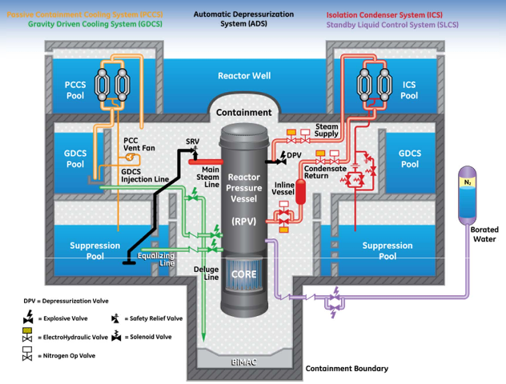
Changes are most evident in the ES-BWR passive safety system:
With essentially complete absence of (must-be-powered) pumps & heat exchangers

Slide 23
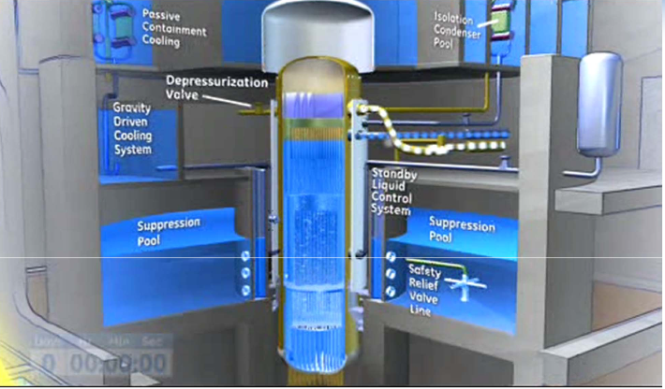
Indeed, squint and it begins to suggest a water park
Which does also have "water, water everywhere"
Arranged in tiers so that it can cascade downward
Falling (at least) by gravity alone
The ES-BWR has (or will have) four different water cooling systems
Fed by gravity (using no pumps in normal operation OR emergency shutdown)
With shutdown initiated without operator intervention (upon loss of DC power)
Vented steam rises, cools, re-condenses & returns via unpowered convection
Reclaiming water w/o the powered sump pump retained in the AP1000

Slide 24
Both ES-BWR and AP1000 thus claim "passive" cooling:
That is, power and pump-free cooling, using only available water
Requiring no operator intervention or continued interaction
Continuing automatically for three days ¹
At which point cooling water would have to be added (or spent water redirected)
Requiring operators but, it is claimed, doable with:
Minimal power (via manual valves or tanker trucks)
After three days, would the reactor core be totally cool? No
But it'd be much, much cooler, likely then incapable of meltdown
Has possibility of zirconium-catalyzed water decomposition been eliminated? No
But chance of required drastic overheating has been sharply reduced
And backup battery-powered hydrogen igniters have been added
To ignite H₂ + O₂ before it could accumulate in explosive quantities

Slide 25
Remaining safety issues and/or controversy?
3-day passive shutdown has not yet been fully tested on either reactor
Apparently because reactor prototypes are deemed too expensive to build
With certifications instead based on plans and simulations
For first time, a NRC commissioner dissented from AP1000 approval
His dissent focused on whether or not it could withstand 9/11 style jetliner impact
Which, on one level, makes sense given target appeal of nuclear reactors
But brings into question lack of protection demanded for other dangerous targets
For instance, our sprawling chemical plants and refineries, see e.g.:
1984 Union Carbide Bhopal India chemical plant explosion:
4,000 dead / 4,000 disabling injuries / 40,000 lesser injuries
For this reason, many new reactor designs are partially/mostly underground!

Slide 26

"Toshiba Likely to Exit Nuclear Plant Construction Business" ¹
Forbes - 29 Jan 2017
But how is Toshiba's decision relevant to the U.S.?
Their name is nowhere on my earlier slide about planned U.S. reactors!
Well, it turns out that Toshiba bought Westinghouse's nuclear business
So they now supervise AP-1000 construction in the U.S.
Including the two reactors under construction at the Vogtle site in Georgia
And the two others at the V.C. Summer site in North Carolina
With losses already in the billions of dollars, all are now on the chopping block
Leaving only one possible Gen III reactor type in the U.S. (GE's ES-BWR)?

Slide 27
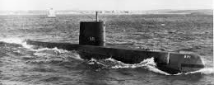
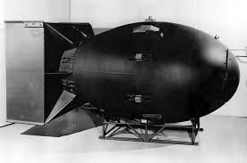
Part II: Long Term Safety = Spent Fuel Safety
This brings us to Gen IV Reactors (only some of which target spent fuel safety)
These designs are not always new. In fact, some are very old
Because, at the birth of the "nuclear age" all sorts of reactors were explored
But the focus (and funding) then quickly turned to the the Cold War
Which drove us (and others) to abandon reactor designs that could NOT:
1) Fit into submarines =>"Mutually Assured Destruction" (MAD)
2) Produce the plutonium used in mega nuclear weapons
Both of which led to an emphasis on Uranium fueled reactors
And only recently have some of those abandoned reactor ideas been resurrected

Slide 28
Requiring us to revisit the basics of nuclear fission and its fuels:
Any atom that eventually breaks apart via fission is called a fissonable atom
²³⁸ Uranium is fissionable
Which makes it radioactive, with a half-life of 4.6 billion years
But no matter how ²³⁸ U is concentrated, it will not start a chain reaction
That is: Individual ²³⁸ U atoms will still randomly fission
But fission of one will not reliably induce the fission of another
A chain reaction (as occurs in bombs or reactors) instead requires a fissile atom
Upon fissioning, a fissile atom must also produce enough neutrons,
and/or so strongly absorb the neutrons it does produce,
that the fission of one atom will reliably stimulate the fission of another

Slide 29
Surprisingly, the only naturally occurring fissile atom on earth is ²³⁵ U
But even ²³⁵ U will not launch a chain reaction at low concentrations
Because, upon fissioning, it emits high kinetic energy (fast) neutrons
Which are only weakly absorbed by other ²³⁵ U atoms
Thus, to overcome this inefficiency, bombs use concentrated 80% ²³⁵ U
U.S. reactors instead use 4% ²³⁵ U, overcoming weak absorption in another way:
Some fast neutrons are slowed down by adding a neutron moderator
Becoming slow neutrons, they will be absorbed by other ²³⁵ U atoms
AND: Remaining un-slowed fast neutrons will induce fission of ²³⁸ U
Which makes up the balance of the reactor's fuel

Slide 30
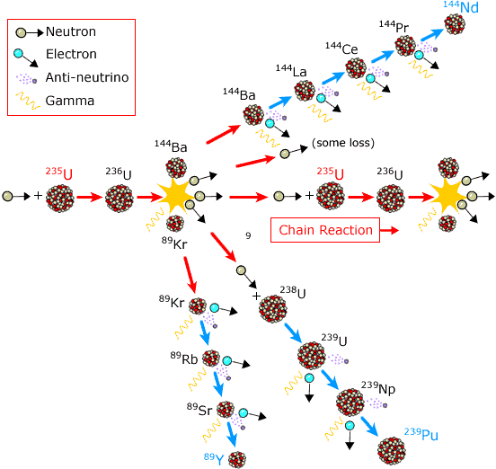
=> Fission reactions in a ²³⁵U / ²³⁸U fueled nuclear reactor:
But this diagram is incomplete with reactions going right off the edge of the figure
And some side reactions are not depicted at all, including one that generates Xenon
If this is our one and only choice of nuclear reactor reactions,
what can we possibly CHANGE to reduce long-lived nuclear waste?

Slide 31
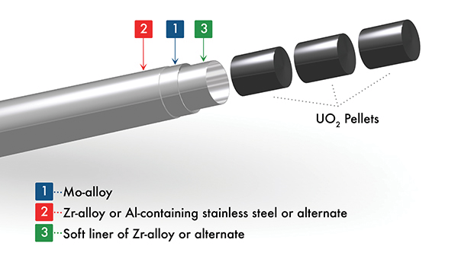
We can reduce the amount of spent fuel by spending more of it!
The above (near universal) scheme uses fuel composed of 4% ²³⁵ U + ²³⁸ U
In the form of solid uranium oxide pellets encased in a zirconium alloy tube ¹
But that fuel rod is then removed from the reactor after, at most, two years
At which time only a quarter (or less) of its starting ²³⁵ U has fissioned!
And as little as 4% of the fuel's potential energy has been extracted ²
Why on earth don't we continue to "burn" that fuel until
all of the ²³⁵ U has fissioned and all of the energy has been extracted?!

Slide 32
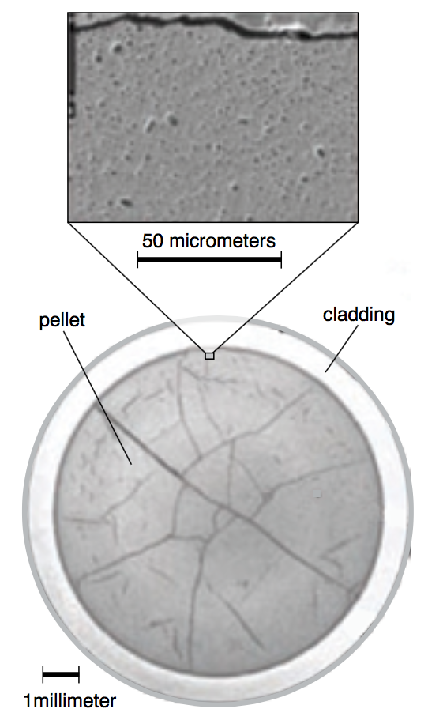
Reason #1 for premature fuel rod replacement: New Atoms
To facilitate the necessary conduction of heat outward from the nuclear fuel,
the starting UO₂ fuel pellets fit snugly within the metal fuel rods
But after two years of fissioning, entirely new atoms have been created
These include MORE atoms, BIGGER atoms and GASEOUS atoms
But ALL of these atoms are STILL crammed inside the same sealed metal tubes!
Tremendous stresses thus build up within these fuel rods
As evident by the cracks within the fuel rods shown here: ¹
And in an Oak Ridge National Lab (ORNL) study ²
These stresses could fracture the fuel rod shell ("cladding")
which would result in a massive radioactivity release

Slide 33
Reason #2 for premature fuel rod replacement: Xenon
Among the fission products produced (along a path NOT shown in the earlier figure)
is Xenon, which is both a gas and a strong neutron poison
By "eating" neutrons, neutron poisons tend to extinguish fission chain reactions
So that after two years, while the fuel rods still contain ~ 3% ²³⁵ U,
that Xenon-tainted ²³⁵ U fissions much less efficiently
Stress build-up endangers safety / Neutron poisoning impacts efficiency
So fuel rods are removed LONG before their full energy is expended
Despite the fact that fuel rod use & radioactive waste would be cut by:
4X if all the ²³⁵ U energy had been used
And by perhaps 25X if ALL of the fuel's potential energy had been used

Slide 34
But it would be even better than that:
With longer use, residual fuel rod radioactivity decreases!
Because not only would the ²³⁵ U and ²³⁵ U be more efficiently "burned up"
But, under intense radiation, all sorts of fission reactions accelerate
Thus even more energy would be released while still inside the reactor AND
Byproducts would move farther down their nuclear fission reaction paths
Meaning, as waste, they'd take less time to become low or non-radioactive

Slide 35
So how might you eliminate stress build-up and get rid of Xenon?
By dissolving the fissile and fissionable atoms of nuclear fuel in a liquid
Albeit one that stays liquid at extremely high temperatures
And then using the resultant liquid as the reactor's fuel:
Movement of unconstrained liquid spontaneously relieves stress AND
Gaseous Xenon neutron poison would bubble right out of the liquid
The liquids of choice are molten salts
For many of the same reasons they are chosen for Solar Thermal heat storage
The resulting reactor is called a Molten Salt Reactor
As successfully demonstrated in ORNL's 1965 Molten Salt Reactor Experiment ¹
Which did, however, yield the acronym of MSRE (try pronouncing it)

Slide 36
But the MSRE reactor did not simultaneously meet Cold War goals
The prototype was not submarine-ready, nor did it churn out bomb-ready plutonium
So MSRE was abandoned in favor solid uranium fueled reactors
One class of which was really good at producing plutonium:
BREEDER REACTORS
"Breeding" refers to the creation of NEW types of fissile atoms
A normal reactor's ²³⁸ U side reaction "breeds" fissile Plutonium:
Which is a prime atomic-bomb-making material
Breeder Reactors are designed to increase such breeding
And their Pu breeding made them a Cold War favorite in the U.S. and U.S.S.R.
But, when the world's attention finally turned to the threat of nuclear proliferation,
breeder reactors became a pariah technology

Slide 37
But breeders might now offer a solution to nuclear waste:
Because their exploitation of radiation DOES accelerate fission decay reactions
Which, as described above, could be used to lessen radioactivity in nuclear waste
At least if we could effectively close the door upon
its simultaneous generation of bomb-making materials
This MIGHT now be possible by turning to non-Uranium fuels
usable in MSRE style liquid fueled nuclear reactors
But the challenges would then be:
1) HOW do we close the door on nuclear proliferation?
2) WHAT OTHER FUEL IS THERE when only ²³⁵ U is naturally fissile?

Slide 38
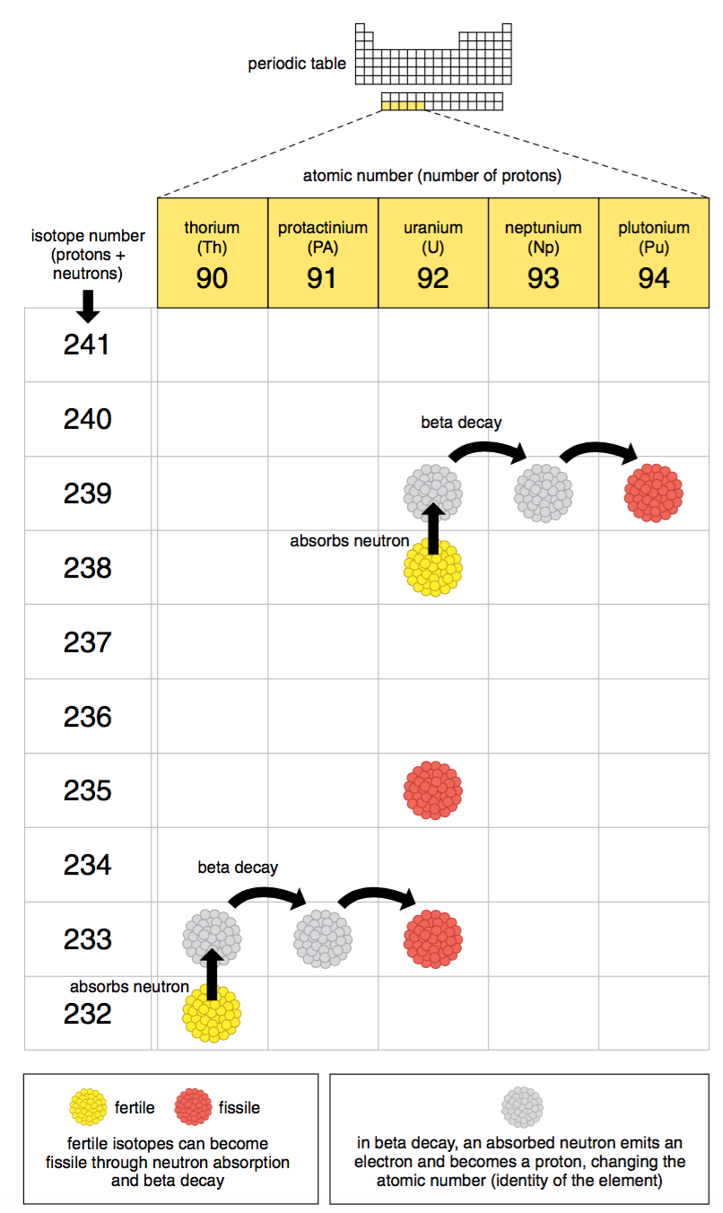
A possible "unnatural" fissile fuel: ²³³ Thorium
It is NOT found naturally within the earth's crust
But the more stable ²³² Thorium isotope is,
and via a "breeder" nuclear reaction
²³² Th transmutes into ²³³ Th
Transmutation Reaction diagrams:
Row = Atomic Mass = #Protons + #Neutrons
Col = #Protons = #Electrons => Atom's Name
Red = fissile (chain-reacting) atom
Yellow = Transmutable into a fissile atom
= "fertile" atom
Here showing bottom row of the Periodic Table

Slide 39
If a neutron is absorbed into the nucleus: Move up the diagram
If neutron converts to proton + beta (high energy electron), move to right
²³⁵ U is the lone ready-to-go fissile atom (near the center of the diagram)
²³⁸ U can be converted to ²³⁹ U
Which, via the reactions at the top,
is then converted to fissile ²³⁹ Pu
²³² Th can be converted to ²³³ Th
Which, via the reactions at the bottom,
is then converted to fissile ²³³ U
²³² Th, like ²³⁸ U, IS also found in the crust,
AND it is 3-4X more abundant ^{1, 2}

Slide 40
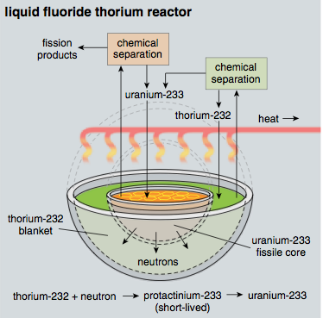
Exploiting this in a liquid fluoride thorium reactor (LFTR):
Which is a molten salt based reactor (MSRE) that, via breeding,
can transmute (convert) dilute fertile ²³² Th into concentrated fissile ²³³ U
It consists of these parts, doing these things:
1) A reactor core fueled by fissile ²³³ U
With that ²³³ U created from earlier ²³² Th
Graphite moderator in core thermalizes neutrons emitted by ²³³ U
2) A surrounding liquid blanket containing ²³² Th
3) Thermal neutrons shoot out into blanket
Transmuting ²³² Th into ²³³ Th
²³³ Th then transmutes into ²³³ U
4) ²³³ U is then transferred from blanket to core
via "chemical separation" (!!??)

Slide 41
Process for ²³³ U transfer & concentration in the reactor core:
THE LFTR BLANKET AND CORE are filled with hot liquid fluoride salt
In that liquid salt, ²³³ U forms soluble (i.e., dissolved) ²³³ U F₄
²³² Th similarly forms soluble ²³² Th F₄
IN THE BLANKET: Added excess fluorine converts ²³³ U F₄ into gaseous ²³³ U F₆
That ²³³ U F₆ gas naturally bubbles out of the blanket
But ²³² Th F₄ does NOT convert into ²³² Th F₆, so it remains in the blanket
IN THE CORE: Gaseous ²³³ U F₆ from the blanket is bubbled in
But hydrogen gas is also bubbled into the core
And via an electrochemical "redox" reaction ¹
the ²³³ U F₆ is "reduced" back into salt-soluble ²³³ U F₄
thereby trapping (and concentrating) the ²³³ U in the core

Slide 42
A diagram that, hopefully, makes sense of the preceding two slides:
H₂
F₂
²³³ U F₆
²³² Th
F
²³³ U F₄
²³² Th F₄
²³³ U F₄
²³³ Th F₄
²³³ Pa F₄
Beta
Beta

Slide 43
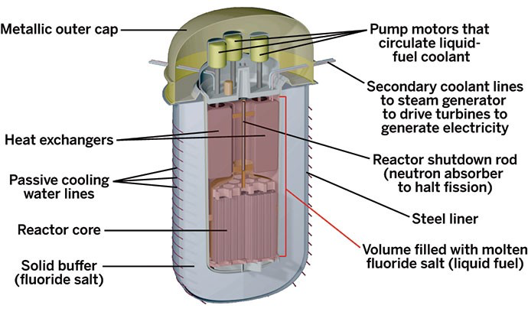
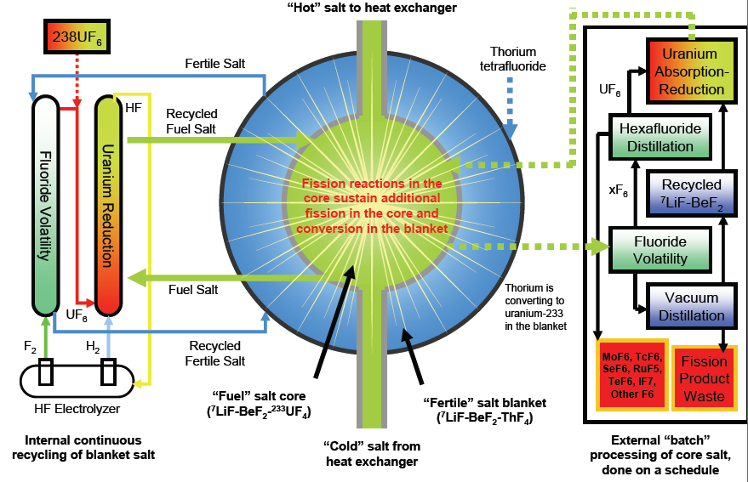
But the real reactor wouldn't be just a couple of open shells:
The reactor core itself might be packaged up as shown on the left
With conversions & transfer functions implemented as shown on the right:
Complexity (pumps, redox reactors, gas transfer . . .) raises an obvious question:
Might LFTR reactors enhance nuclear waste safety
only at the expense of diminished operational reliability & safety?
http://cen.acs.org/articles/93/i27/Trying-Unleash-Power-Thorium.html

Slide 44
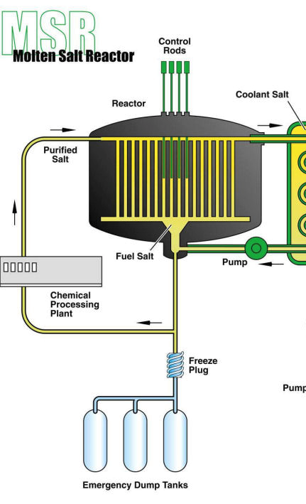
It's claimed that LFTR's would actually increase short term safety:
Firstly, because the reactor eliminates extreme high pressure piping (as in PWR's)
Secondly, because molten salts expand upon overheating:
=> Which spreads fissile ²³³ U atoms farther apart
=> Diminishing likelihood of emitted neutrons hitting other ²³³ U
=> Attenuating fission chain reactions (= Negative Feedback)
Thirdly, because LFTR's have a built-in solid salt drain plug
If the reactor tries to overheat, that plug melts
Allowing molten salt from the reactor (w/ nuclear fuel)
To drain out into multiple small compartments
Yielding (it's claimed) immediate pump & water-free
"passive shutdown" of the reactor (the Gen III ideal!)

Slide 45
So back to the other claim of long term safety enhancement
That is, the claim that LFTR's would radically diminish nuclear waste
This is based, firstly, on the use of liquefied nuclear fuels
which eliminates the fuel rod problem of accumulating stress & Xenon
Allowing nuclear fuel to be used longer, and to be much more completely "burned"
THUS: Necessary amount of fuel drops radically (e.g., by 4X – 25X)
AND: Fuel that does exit the reactor has been more completely fissioned
So its atoms are much closer to transmuting into non-radioactive atoms
Secondly, ²³³ Th radioactive products have intrinsically shorter lifetimes:
Heavy actinide atoms have notoriously long-lived radioactivity
The most persistent actinides have transuranic masses of ≥ 239
These form easily from heavy ²³⁸ U, but not from lighter ²³³ Th

Slide 46
This argument shown graphically, first for common fission:
Atomic Mass
Heavier unstable nucleus
splits apart (fissions)
into much smaller nuclei
Neutron
Nucleus
Nucleus captures neutron
becoming slightly heavier
Time

Slide 47
But for nuclei mass ≥ 239, transuranic actinides can be formed:
Atomic Mass
Transuranic actinide decay: 10's to 100's of MILLENIA
240
Neutron
More common fission decay:
100's to 1000's of YEARS
Alternate Nuclei
230
Time

Slide 48
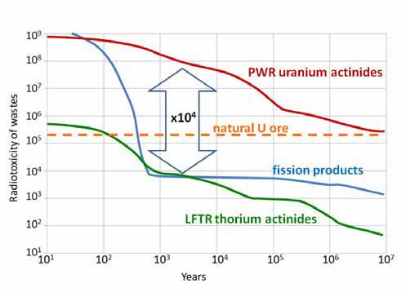
Comparison of Thorium LFTR and Uranium PWR radioactive waste
From American Physical Society's "Forum on Physics & Society"
THE professional society all U.S. physicists (and many/most international physicists)
"Thorium & uranium fueled reactors produce essentially the same fission products, whose radiotoxicity in 500 years drops below that of the original ore mined for uranium to power a PWR.
(But) a LFTR would create far fewer transuranic actinides than a PWR.
(Thus) after 300 years the LFTR waste radiation would be 10,000 times less"
High quantities of heavy persistent transuranic actinides produced in uranium fueled PWR's
Lighter (suburanic) faster decaying fission products,
as produced by ALL reactors
Much lower quantities of heavy persistent transuranic actinides produced by Thorium fueled LFTR's

Slide 49
Which leaves us with the question of non-proliferation
THIS has been the standing argument against all types of "breeder" reactors
ALL of which are designed to "breed" NEW fissile atoms
As occurs within a LFTR as it breeds new ²³³ U from ²³² Th
For non-proliferation one must block breeding of bomb-ready fissiles such as ²³⁹ Pu
How and why a ²³² Th fueled LFTR might meet that challenge:
1) Light ²³² Th can't easily breed heavy ²³⁹ Pu = actinide argument revisited:
Each ²³² Th nucleus would have to capture a neutron seven times!
2) And, in a ²³² Th fueled LFTR, significantly fewer neutrons are produced
So if fissiles are clandestinely removed from the reactor (for bomb making),
reactor's sustaining fission chain reactions can actually be extinguished
(sharply limiting possible production/diversion of fissiles)

Slide 50
Plus one more somewhat double-edged argument: ^{1, 2}
3) In addition to breeding ²³³ U, a Thorium LFTR also breeds some ²³² U
²³² U has a half life of 73.6 years (making it strongly, if briefly, radioactive)
When it decays, it releases gamma rays
Gamma rays = Extreme high energy photons, having neither charge nor mass
This allows gamma rays to penetrate matter much more easily than
conventional decay products such as neutrons and beta particles
Gamma radiation is thus known to interfere with a bomb's electronic controls
This can be reduced by adding shielding inside the bomb (e.g., thick lead)
But that can radically increase the bomb's weight and size
Leading bomb makers to strongly avoid gamma ray producers
But that ALSO means shielding of LFTR reactors must be enhanced!

Slide 51
This lecture presents us with some very hard choices:
Climate scientists warn that global warming must be addressed within 10-20 years
At least, they claim, if we are to avoid huge, world-wide, consequences
As discussed in Carbon Power lecture, in 2014 -15 U.S. power generation was:
67% greenhouse gas producing / 33% non-greenhouse gas producing
With latter breaking down as 1% solar + 5% wind + 7% hydro + 20% nuclear
If we now abandon nuclear, to hold U.S. carbon emission constant:
Solar + wind power would have to grow ~ 4X (6% => 6% + 20% = 26%)
To counter climate change, U.S. promised 40% greenhouse gas reduction by 2025 ¹
Solar + wind (discontinuing nuclear) would have grow ~ 10X
(6% => 6% + 20% + 0.4 x 67% = 53%)

Slide 52
Within one decade (or thereabouts)?!!!
Given the economic & technological challenges of such a radical/rapid expansion,
COUPLED WITH the current (stunning!) U.S. lack of political will,
I find the preceding (nuclear-free) transition completely implausible
Instead, we seem to face an EITHER/OR (lesser of two evils) choice:
Turn off nuclear energy OR confront climate change
To meet BOTH GOALS we'd instead have to:
Continue using nuclear (or even expand our use of it)
for at least long enough to let wind, solar, etc. radically grow

Slide 53
Exploring that dual goal third option:
Because we stopped building nuclear reactors after the 1979 TMI accident:
We are now operating very old reactors, well beyond their intended lifetimes
This compounds the risks of their already less safe designs
Suggesting their replacement with newer & intrinsically safer designs
Gen III/III+ reactors, such as the AP1000 (?) & ES-BWR are available NOW
Offering way to cut greenhouse emissions while improving short term safety
Gen IV reactors such LFTR's promise both short AND long term nuclear safety
But only one LFTR was ever been built, and briefly operated, 50 years ago
It could take 20+ years to now fully test and commercialize LFTR's

Slide 54
Suggesting investment in already available Gen III/III+ designs
But Gen III/III+ designs are derivatives of Gen II designs
Which have lasted for more than 40 years
And because such designs have notoriously high construction costs
Power companies will fight premature shut down of new Gen III/III+ reactors
Yielding Scenario 1: We now invest in new Gen III/III+ reactors
These improve short-term operational safety
Eliminating, we hope, prospect of TMI/Chernobyl/Fukushima type accidents
But not addressing long-term safety as, for 40+ years, these Gen III's
continue to churn out extremely long-lived nuclear waste
Versus Scenario 2: Invest in Gen IV reactors such as LFTR
Which offer both short-term and long-term safety breakthroughs

Slide 55
But to fall within the claimed 10-20 year window of opportunity:
Gen IV development, testing, & commercialization would have to vastly accelerated
Instead, countries are announcing their intention of bailing on nuclear
As U.S. Department of Energy sponsors only a very timid research program
(Which the new administration is threatening to slash!)
But a very strange, indeed unprecedented, nuclear alliance has now been formed:
The developer of the original MSRE / LFTR prototype, Oak Ridge National Lab
Has entered into a technology sharing agreement with China
In that agreement, signed in 2011, China announced that: ¹
700 nuclear engineers working at the Shanghai Institute of Applied Physics,
would produce a 2 MW prototype LFTR reactor by 2020,
with full commercial scale up then intended by 2030
1) https://www.technologyreview.com/s/542526/china-details-next-gen-nuclear-reactor-program/

Slide 56
In 2015, a second more ambitious agreement was announced:
A Cooperative Research and Development Agreement (CRADA) ¹
Which does NOT focus exclusively on LFTR development
But which does increase funding on the Chinese side
And accelerates the development schedule to just 10 years
All of which could end up producing the rather ironic result that:
Our entirely reasonable fear of past nuclear accidents backed us into a box
An escape from which might now be opening based on:
China's fear of the carbon gas emission impact upon their cities
(Coupled with what they see as a huge commercial development opportunity)
1) http://fortune.com/2015/02/02/doe-china-molten-salt-nuclear-reactor/

Slide 57
To Close: Today I described only one Gen IV reactor proposal
But there are literally dozens of other Gen IV ideas being explored
You can learn more about some of them in my mini-lecture:
Next Generation Nuclear Power – Part II
Which includes: Gas-Cooled Reactors (including the Pebble Bed Reactor),
Fast Reactors and Fast Breeder Reactors,
TerraPower's Traveling Wave Reactor,
and Small Modular Reactors

Slide 58
Other class lectures on nuclear energy:
The lecture introducing nuclear energy & its accidents:
Nuclear Energy – But they blow up! (link)
The follow-on to this "Next Generation Nuclear Power" lecture:
Other Gen IV Nuclear Reactors (link)
A bonus mini-lecture describing something truly remarkable:
Prehistoric Natural Reactors? (link)

Slide 59
Credits / Acknowledgements
Some materials used in this class were developed under a National Science Foundation "Research Initiation Grant in Engineering Education" (RIGEE).
Other materials, including the "UVA Virtual Lab" science education website, were developed under even earlier NSF "Course, Curriculum and Laboratory Improvement" (CCLI) and "Nanoscience Undergraduate Education" (NUE) awards.
This set of notes was authored by John C. Bean who also created all figures not explicitly credited above.
Copyright John C. Bean (2017)
(However, permission is granted for use by individual instructors in non-profit academic institutions)
An Introduction to Sustainable Energy Systems: www.virlab.virginia.edu/Energy_class/Energy_class.htm

